Slide 1

Course Code: CS-111

Slide 2
Instructor: Isra naz(Lecturer, Deptt of Computer Science, University of Wah, Wah Cantt).
Contact Information: isra.naz@uow.edu.pk

Slide 3

Assessment | %Age
Assignments/ Quizzes | 7.5% + 11.25% = 18.75%
Viva/Sessional | 10% + 15% = 25%
Mid Term Exam | 22.5%
Final Term Exam | 33.75%
Total | 100

Slide 4
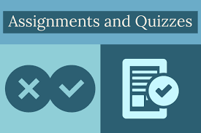

Assignments
Assignments will be due at the beginning of the class. Under normal circumstances, late work will not be accepted.
Students are expected to do their own assignments.
Plagiarism will be observed strictly.
Surprise/ Announced quizzes to assess the understanding of taught topics.

Slide 5

Revise the topic covered in class the same day.
Complete the tasks given, you might get bonus points for that. ☺
Feel free to consult me during my office hours.

Slide 6


Show sensibility in your conduct.
Learning should be your primary objective.
Attendance will be marked within 15 minutes at the start of the class.
80% of your attendance is mandatory.
Zero tolerance policy on attendance, discipline in class during lectures.
Assignments must be submitted on time, no late submissions.
In case of copied assignment both parties will be given zero.
Don’t miss your Classes, Quizzes, Presentations, Assignments and Projects/Presentations.
You all need to be a good human being.

Slide 7

The key objectives of this course include are:
To familiarize students with basic structured programming concepts.
To emphasize upon problem solving and algorithm designing.
To Design and implement algorithms to solve real world problems.
To understand the importance of modular programming structure and reusability.

Slide 8

Upon successful completion of this course, students will:
Understand basic problem-solving steps and logic construct.
Apply basic programming concepts.
Solve real world problems by designing and implementing algorithms.

Slide 9

PLOs/CLOs | CLO1 | CLO2 | CLO3
PLO1 (Academic Education) | ✔
PLO2 (Knowledge for Solving Computing Problems) | ✔ | ✔
PLO3 (Problem Analysis) |  | ✔ | ✔
PLO4 (Design/Development of Solutions)
PLO5 (Modern Tool Usage)
PLO6 (Individual and Teamwork)
PLO7 (Communication)
PLO8 (Computing Professionalism and Society)
PLO9 (Ethics)
PLO10 (Life-long Learning)

Slide 10
Computer basics
Problem solving tecnhniques
Basics of C++ (Variables, Constants, Data types etc.).
Conditional statements
Iterative statements
Jump statements
Arrays & Functions
Structures & Pointers
String Handling
Static vs. Dynamic memory allocation
Exception Handling
File Handling

Slide 11
Text Books:
Problem Solving and Program Design in C++, by Jeri R. Hanly & Elliot B. Koffman, 7th Edition 2012, ISBN: 978-0132936491
Reference Books:
Object Oriented Programming in C++ by Robert Lafore, 2001, ISBN: 978-0672323089
C++ Primer, by Stanley B. Lippman, Josee Lajoie, and Barbara E. Moo, 5th Edition 2012, ISBN: 978-0321714114

Slide 12

Von Neumann Architecture
Computer Organization
Data vs. Information
Data Hierarchy, Programming languages
High level and low level languages
Syntax vs. Semantics
Language processor/ Translators

Slide 13

A computer is a digital electronic machine that can be programmed to carry out sequences of arithmetic or logical operations (computation) automatically. Modern computers can perform generic sets of operations known as programs. These programs enable computers to perform a wide range of tasks.

Slide 14
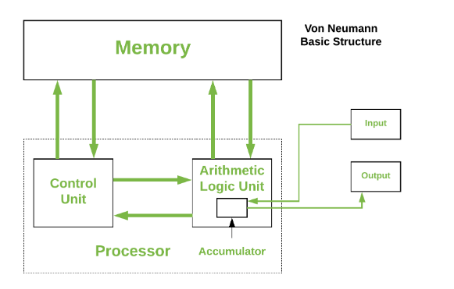
Von-Neumann proposed his computer architecture design in 1945 which was later known as Von-Neumann Architecture.
It consisted of a Control Unit, Arithmetic, and Logical Memory Unit (ALU), Registers and Inputs/Outputs.
Von Neumann architecture is based on the stored-program computer concept, where instruction data and program data are stored in the same memory. This design is still used in most computers produced today.
The basic structure is like,

Slide 15

A Von Neumann-based computer:
  Uses a single processor
  Uses one memory for both instructions and data.
  Executes programs following the fetch-decode-execute cycle
Object-Oriented Programming
Lecture 2

Slide 16
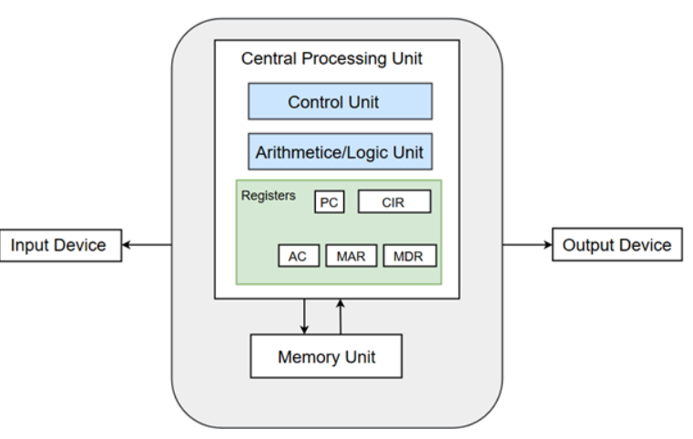

Slide 17

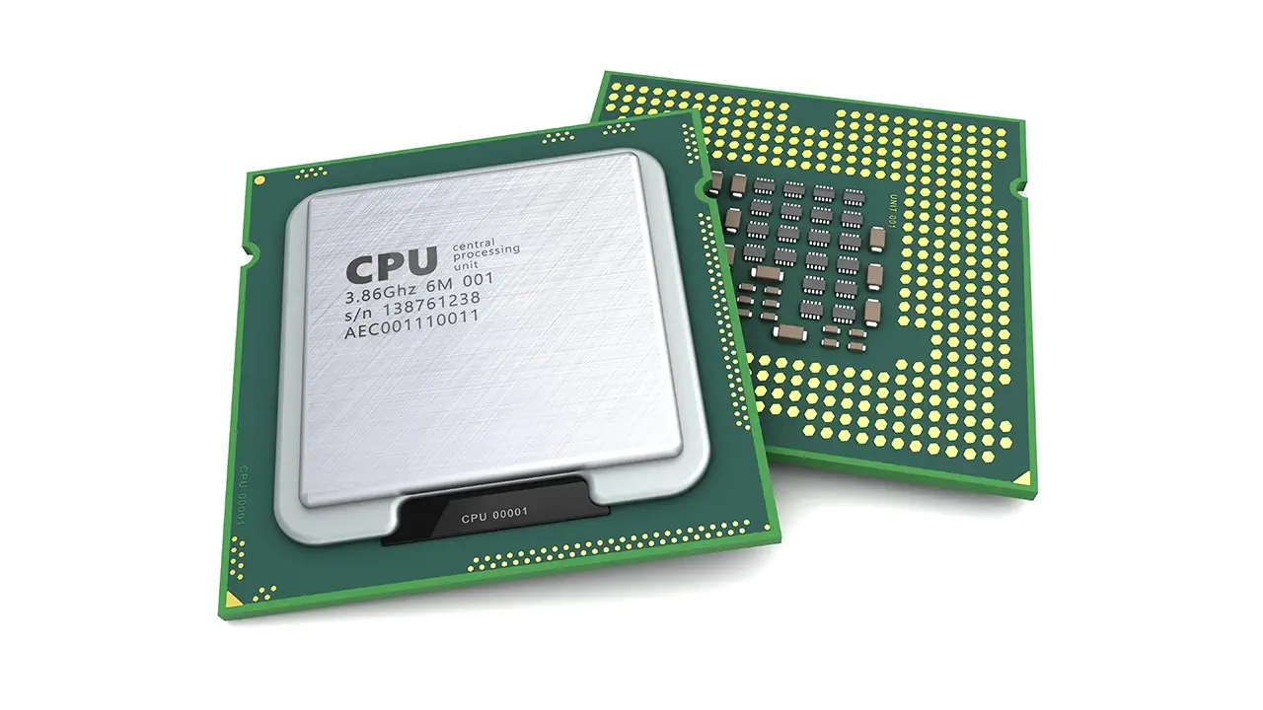
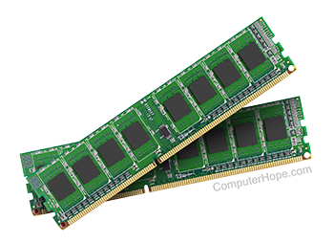
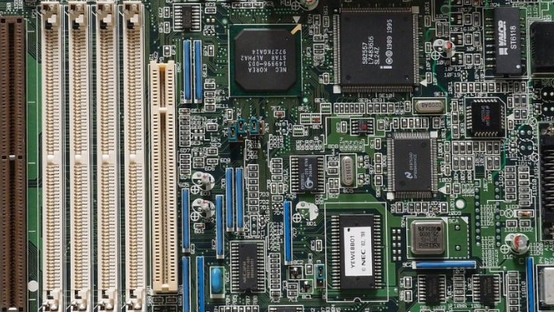
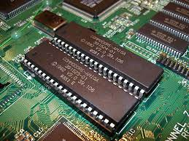
3 basic components are:
  Central Processing Unit
  Buses
  Memory Unit

Slide 18

Data is a collection of facts, while information puts those facts into context.
Data is raw and unorganized, information is organized.
Data points are individual and sometimes unrelated. Information maps out that data to provide a big-picture view of how it all fits together.

Slide 19

A set of instructions that tells a computer what to do.
Computer programs are written in programming languages
The programmer develops programs to instruct the computer how to process data to convert into information.
A Programming Language is
  A special purpose and limited language
  A set of rules and symbols used to construct a computer program
  A language used to interact with the computer

Slide 20

There are two types of programming languages
  Low level languages
  High level languages

Slide 21

These languages are near to computer hardware and far from human languages
Computer can understand these languages easily
Writing a program in low level languages require a deep knowledge of the internal structure of computer hardware
Low level languages are of two types:
  Machine Language
  Assembly Language

Slide 22

  A type of language in which instructions are written in binary form.
  It is the only language that is directly understood by computer
  Instructions specify operations and memory cells involved in the operation
  Program can be executed very fast
  It is machine dependent
  Difficult to understand
  Modification requires a lot of time
  Also known as first generation language

Slide 23

It is one step higher than machine language
In assembly language, symbols are used instead of binary code
These symbols are called mnemonics
Also called as symbolic language
Program written in assembly language is easier to write and modify
Mostly used in writing system software
It is also known as second generation language
Example:
  Load Price
  Add Tax
  Store Cost

Slide 24

A type of language that is close to human language
It uses statements consisting of English-like keywords such as "FOR", "PRINT" or “IF“, ... etc.
Each statement corresponds to several machine language instructions (one-to-many correspondence).
Much easier to program than in assembly language.
Data are referenced using descriptive names
Operations can be described using familiar symbols
Example:
Cost := Price + Tax

Slide 25

Procedural Languages
Predefined set of statements
Execute sequentially
User need to tell the computer both “what to do” and “how to do”
e.g. FORTRAN, BASIC, COBOL, C etc.
Non Procedural Languages
User only need to tell the computer “what to do” not “how to do”
It can be used by non-technical user to perform a specific task
For Example, SQL

Slide 26

Object-Oriented Languages
Program written on the basis of objects
An object is a collection of data and function
Object may represent a person, thing, or place in real world
In OOP, data and all possible functions are grouped together
Easier to learn and modify
C++ and Java are popular object-oriented languages

Slide 27

Syntax:
  The structure of strings in some language.
  The structure of the expressions, statements, and program units
  A language's syntax is described by a grammar.
  The syntax of a programming language describes which strings of of characters comprise a valid program.
Semantics:
  The meaning of the expressions, statements, and program units
  The semantics of a programming language describes what syntactically valid programs mean, what they do.

Slide 28

Computer understand only machine language.
A program written in high-level or assembly language cannot be run on a computer directly.
It must be converted into machine language before execution.
Language processor or translator is a software that converts these programs into machine language
Every computer language has its own translator
Types of language processor are
Compiler
Interpreter
Assembler

Slide 29
Compiler
  A program that converts another program from some source language (or high-level programming language / HLL) to machine language (object code) as a whole.
  Program written in HLL is called source program
  Compilers convert source program into machine code is known as object program

Slide 30

Assembly Language
Source
Program
Compiler
Assembly Language
Machine
Language
Assembler
Notes:
Instead of to ML
Facilitates debugging
Isolates compiler from changes in format of ML (new OS)
Only assembler must be changed!

Slide 31
The compiler checks each statement in the source program and generates machine instructions.
Compiler also checks syntax errors in the program.
A source program containing an error cannot be compiled.

Slide 32
Source program
  The form in which a computer program, written in some formal programming language, is written by the programmer.
  Can be compiled automatically into object code or machine code or executed by an interpreter.
  Pascal source programs have extension ‘.pas’

Slide 33
Object program
  Output from the compiler
  Equivalent machine language translation of the source program
  Files usually have extension ‘.obj’
Executable program
  Output from linker/loader
  Machine language program linked with necessary libraries & other files
  Files usually have extension ‘.exe’

Slide 34

A program that pulls other programs together so that they can run.
Most programs are very large and consist of several modules.
Even small programs use existing code provided by the programming environment called libraries.
The linker pulls everything together, makes sure that references to other parts of the program (code) are resolved.

Slide 35

A program that converts one statement of a program at a time
It executes this statement before translating the next statement of the source program
If there is an error in the statements, the interpreter stops working and displays error message
Advantage:
Error is found immediately. So, the programmer can correct errors during program development
Disadvantage:
It is not very efficient. It does not produce an object program.
It must convert the program each time it is executed
Visual Basic uses interpreter

Slide 36

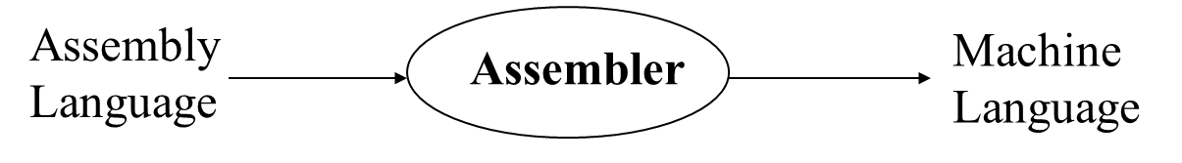
It translates the instruction of an assembly language into machine language

Slide 37
Questions?

